Slide 1
Introduction to Rivanna

Slide 2



Rivanna
Rivanna is the university's primary resource for high-performance computation. It provides a platform for computationally-intensive research across disciplines.

Slide 3
Terminology
Node
Basic building block of a cluster
Usually a specialized computer
Two types of nodes:
Head Node – computer used for logging on and submitting jobs
Compute Node -- computer that does most of the work
Core – an individual processor on a computer

Slide 4


Rivanna Overview
Compute Nodes
Head Nodes
ssh client
Ethernet
Home Directory
Other Storage
Scratch
Infiniband

Slide 5

Before we can use the Cluster . . .
We need to know about:
Allocations & Accounts
Connections to the cluster
Cluster environment
Modules & Partitions
Slurm & Job Submissions
The remaining slides will cover
the basics of these topics.

Slide 6
Allocations

Slide 7
Allocations
Rivanna is allocated:
At the most basic level, an allocation refers to a chunk of CPU time that you can use to run your computations.
Only faculty, postdocs, and research staff may request an allocation.
Students must be sponsored by a faculty or research staff.
All individuals on a given allocation share the service units.
Allocations may be requested at https://www.rc.virginia.edu/userinfo/rivanna/allocations/
Allocations are measured in service units (SUs), where 1 SU = 1 core-hour

Slide 8



Getting an account on Rivanna
Request an Allocation
Receive Allocation and Account(s)
Research Computing
Allows access
Principal Investigator (PI)
Researchers

Slide 9
Connecting & Logging Onto Rivanna

Slide 10
If You are Off-Grounds . . .
You may need to use the UVa VPN when connecting to Rivanna from an off-Grounds location.
To install the VPN on your computer, go to https://in.virginia.edu/vpn and follow the instructions.
During the COVID-19 outbreak, we are asking users to connect with the UVa More Secure VPN if it is available to them.
The UVa Anywhere VPN can be used if the UVA More Secure Network is not available.

Slide 11
How to connect to Rivanna
There are three ways to connect to Rivanna:
Open-on-Demand, a graphical user interface through a web browser
examine and manipulate files and submit jobs.
access applications such as Matlab, Jupyterlab, and R Studio Server.
https://rivanna-portal.hpc.virginia.edu
FastX Web, direct access to a desktop for Rivanna https://rivanna-desktop.hpc.virginia.edu
3. ssh client, direct access to the command line

Slide 12
Connecting to Open OnDemand
To connect to Open OnDemand, open your web browser and type
https://rivanna-portal.hpc.virginia.edu
You will need to authenticate with Netbadge (i.e., “Netbadge” in).
After you log in, you will see the Dashboard.
You can connect to Open OnDemand from off-Grounds locations without a VPN connection.

Slide 13
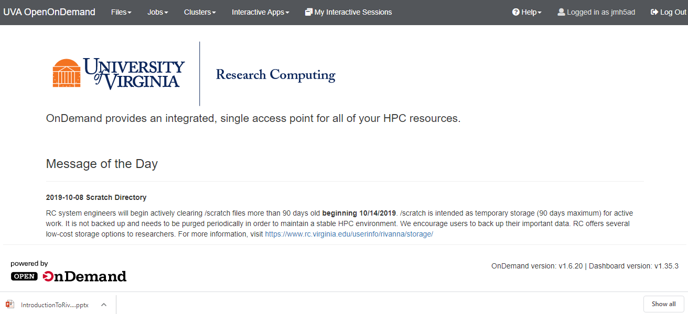
Open OnDemand Dashboard

Slide 14
Open OnDemand Dashboard

Slide 15
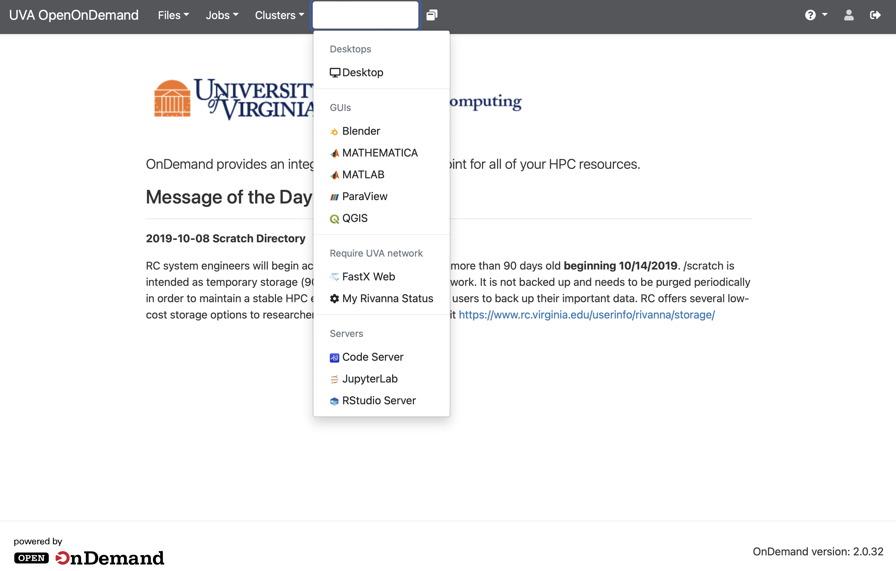
Interactive Apps
Let’s try FastX for now.
You must use the UVa VPN to use FastX from off-Grounds.

Slide 16
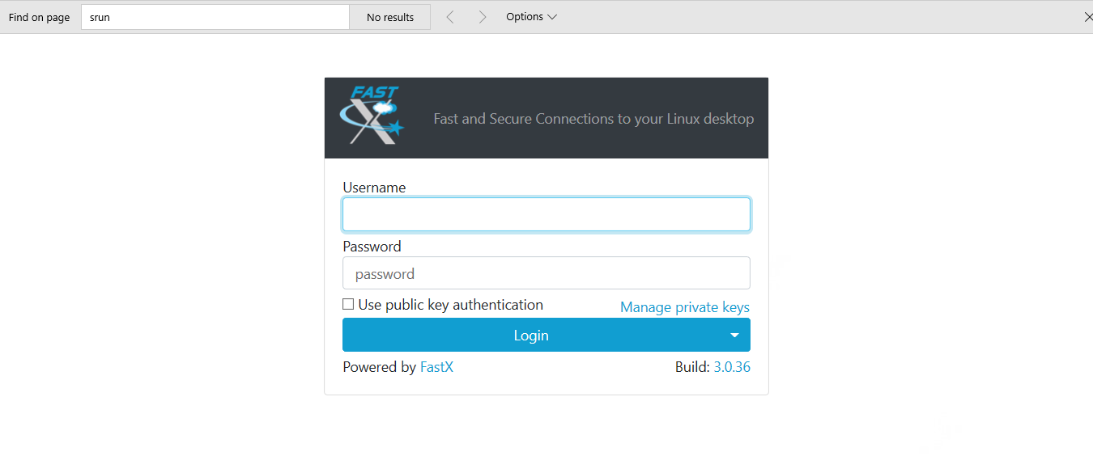
Log in Using Your Netbadge Credential

Slide 17
Log in Using Your Netbadge Credentials
If this page does not appear, make sure that you are connected to the UVa VPN..

Slide 18
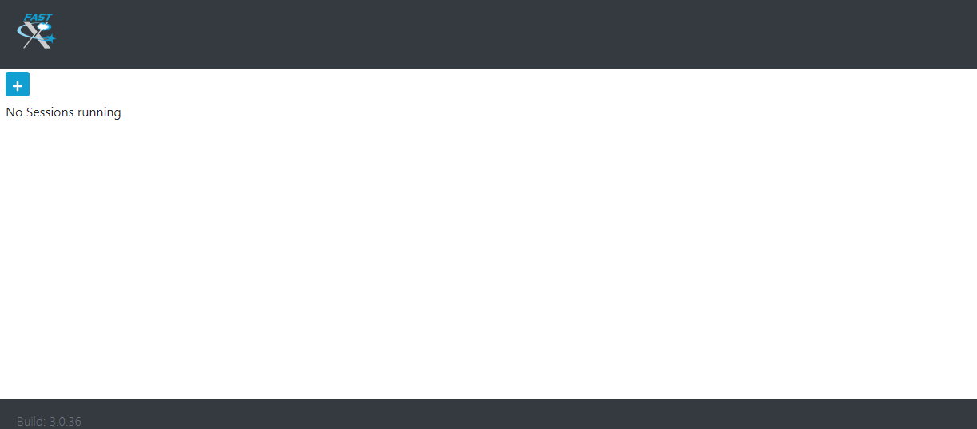
Starting up FastX
Click on the plus sign

Slide 19
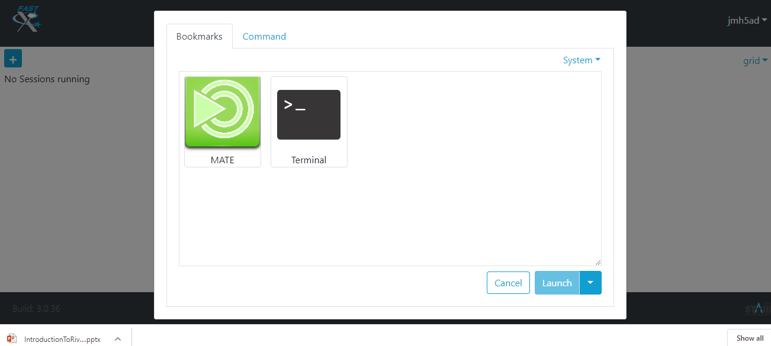
Starting up FastX
Select MATE; Click Launch

Slide 20
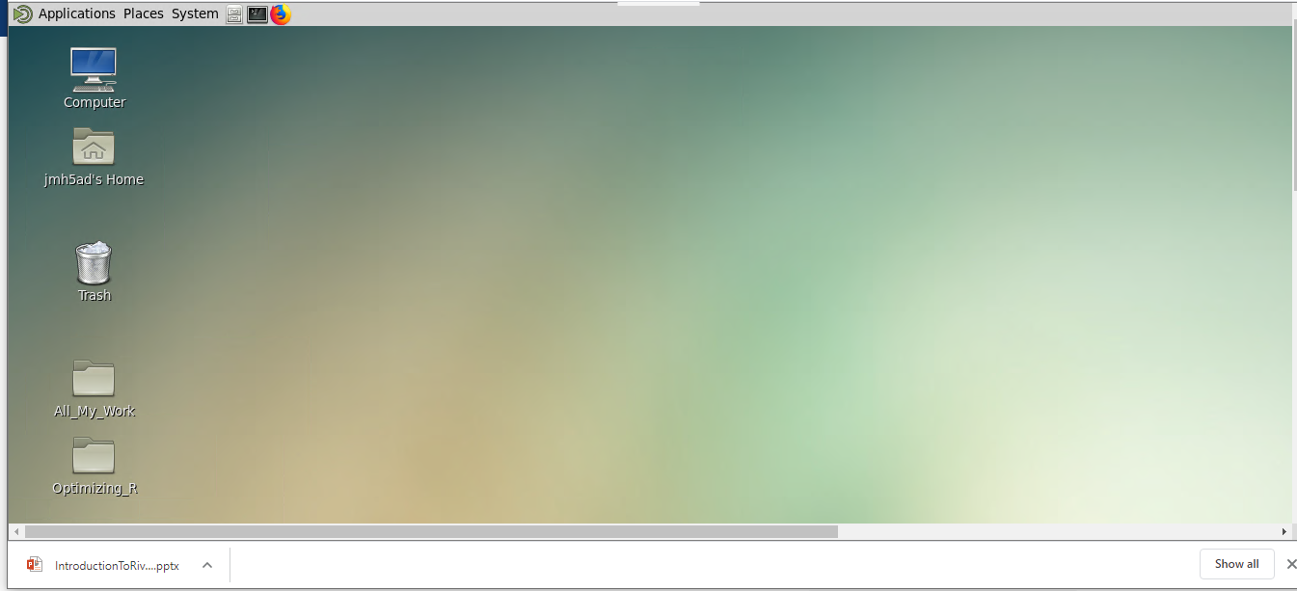
FastX Desktop

Slide 21
Now, let’s see how we can connect with an ssh client.

Slide 22
SSH Clients
Replace mst3k with your user ID.
Connecting to Rivanna
On a Mac or Linux system, simply open a Terminal application and type
ssh –Y mst3k@rivanna.hpc.virginia.edu
You may also want to install XQuartz on your Mac to use graphical tools on Rivanna.
On a Windows system, open the Command Prompt app and type
ssh –Y mst3k@rivanna.hpc.virginia.edu
You must use the UVa VPN when off-Grounds.

Slide 23
SSH Clients
SSH clients mostly use instructions typed at the command prompt.
You will need to become familiar with Linux/Unix commands.
See learning.rc.virginia.edu/tutorials/unix-tutorial/ to learn more
Some useful Unix/Linux commands:
$ ls
$ pwd
$ cd folder_name
$ cp file_1 file_2
$ rm file_1
$ cd ..

Slide 24
Hostnames for Rivanna
The hostname for the Interactive frontends: rivanna.hpc.virginia.edu
(does round-robin among the three front-ends)
However, you also can log onto a specific front-end:
rivanna1.hpc.virginia.edu
rivanna2.hpc.virginia.edu
rivanna3.hpc.virginia.edu

Slide 25
Editing Files

Slide 26
How to edit a file on Rivanna
You can use:
The built-in editor in Open-on-Demand. Just click on Files on the Dashboard, highlight the file that you want to edit and click on the edit button.
When in a Terminal Window, use vi or nano.
vi uses all keyboard shortcuts and may take a while to learn.
nano is a very basic editor. To launch, type: nano myfile.txt
In FastX, you can use gedit or any of your IDEs, like Spyder or Rstudio.

Slide 27
Cluster Environment

Slide 28
After you have logged in . . .
You will be in your home directory, e.g. /home/mst3k.
The home directory on Rivanna has 50GB of storage capacity.
The home directory is for personal use and is not shareable with other users.

Slide 29
Checking your Allocation
To see how many SUs you have available for running jobs, type allocations at the command-line prompt:
$ allocations
Account Balance Reserved Available
-------------- ----------- ------------- ------------
robot_build 25000 0 25000
gizmonic-testing 921.952 0 921.952
crow-lab 928826 6236 922590
gypsy 0 0 0
for more information about a specific allocation, run:
'allocations -a <allocation name>‘
allocations –a crow-lab

Slide 30
Your /scratch Directory
Each user will have access to 10 TB of temporary storage.
It is located in a subdirectory under /scratch, and named with your userID
e.g., cd /scratch/mst3k
The /scratch directory is for personal use and is not shareable with other users.
Important:
/scratch is NOT permanent storage and files that have not been accessed for more than 90 days will be marked for deletion.

Slide 31
Running Jobs from Scratch
We recommend that you run your jobs out of your /scratch directory for two reasons:
/scratch (a storage system designed specifically for parallel access).
/scratch is connected to the compute nodes with Infiniband (a very fast network connection).
We also recommend that
You keep copies of your programs and data in more permanent locations (e.g., your home directory or leased storage).
After your jobs finish, you copy the results to more permanent storage).

Slide 32
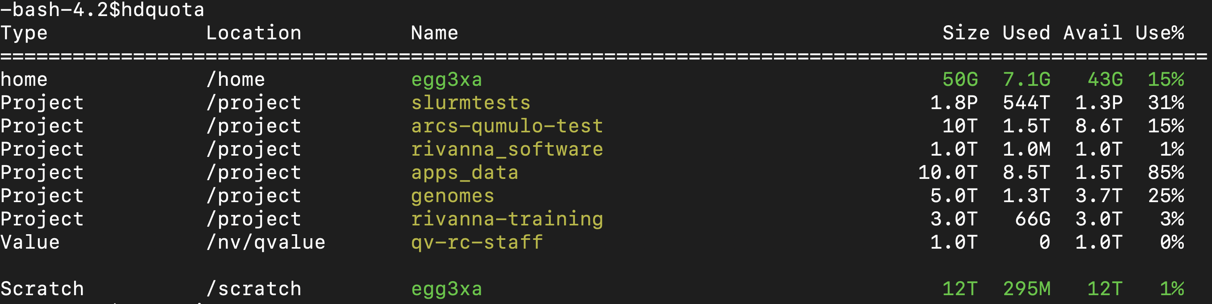
Checking your Storage
To see how much disk space you have used in your home and scratch directories, open a Terminal window and type hdquota at the command-line prompt:
Scratch Limits:
hdquota only shows 12T limit
Running jobs can continue over 10T but data will not be written if 12T is exceeded
If /scratch is over 10T users are put in an over allocation group called “scratch jail”
Prevents you from submitting anymore jobs
Users must cleanup storage below 10T in order to submit new jobs with write access

Slide 33
Moving data onto Rivanna
You have several options for transferring data onto your home or /scratch directories.
Use the scp command in a terminal window.
Use a drag-and-drop option with MobaXterm (Windows) or Cyberduck (Mac OS).
For small files, use the Upload and Download buttons in the Open onDemand Files App
Use the web browser in the FastX desktop to download data from UVA Box.
Use the git clone command to copy git repositories
Set up a Globus endpoint on your laptop and use the Globus web interface to transfer files.
(See https://www.rc.virginia.edu/userinfo/globus/ for details)

Slide 34
Modules

Slide 35
Modules
Any application software that you want to use will need to be loaded with the module load command.
For example:
module load matlab
module load anaconda/2020.11-py3.8
module load goolf/7.1.0_3.1.4 R/4.0.0
You will need to load the module any time that you create a new shell
Every time that you log out and back in
Every time that you run a batch job on a compute node

Slide 36
Module Details
module avail – Lists all available modules and versions.
module spider – Shows all available modules
module key keyword – Shows modules with the keyword in the description
module list – Lists modules loaded in your environment.
module load mymod – Loads the default module to set up the environment for some software.
module load mymod/N.M – Loads a specific version N.M of software mymod.
module load compiler mpi mymod – For compiler- and MPI- specific modules, loads the modules in the appropriate order and, optionally, the version.
module purge – Clears all modules.

Slide 37
Learning more about a Module
To locate a python module, try the following:
To find bioinformatics software packages, try this:
The available software is also listed on our website:
https://www.rc.virginia.edu/userinfo/rivanna/software/complete-list/
$ module avail python
$ module spider python
$ module key python
$ module key bio

Slide 38
Partitions (Queues)

Slide 39
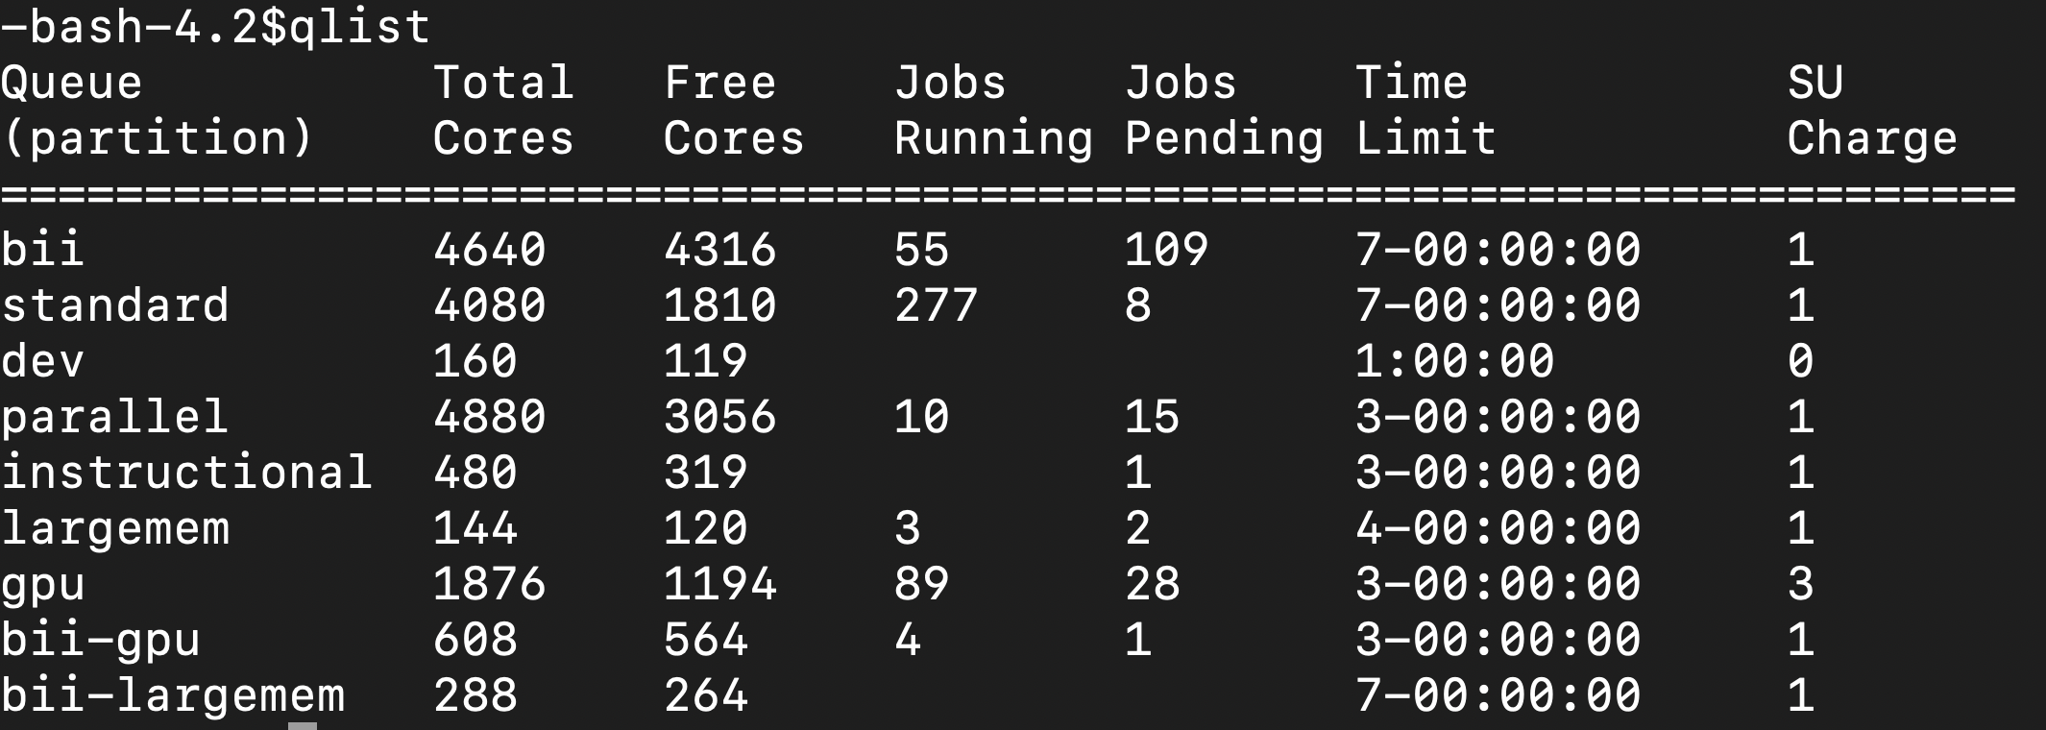
Partitions (Queues)
Rivanna has several partitions (or queues) for job submissions.
You will need to specify a partition when you submit a job.
To see the partitions that are available to you, type qlist at the command-line prompt.
bii, bii-gpu, bii-largemem are only available upon special request

Slide 40
Compute Node Partitions (aka Queues)
Queue Name | Purpose | Max time / job | Max nodes / job | Max cores / job | Max cores /node | Default memory /core | Max memory /node / job | SU Charge Rate
standard | For jobs on a single compute node | 7 days | 1 | 37 | 37 | 9 GB | 750 GB | 1
gpu | For jobs that can use general purpose graphical processing units (GPGPUs) (K80 or P100) | 3 days | 4 | 32 GPUs | 125 | 6 GB | 1953 GB | 3
parallel | For large parallel jobs on up to 50 nodes (<= 1850 cores/job) | 3 days | 50 | 1500 | 40 | 9 GB | 375 GB | 1
largemem | For memory intensive jobs (<= 45 cores/node) | 4 days | 2 | 32 | 45 | 60 GB | 1464 GB | 1
dev | To run jobs that are quick tests of code (<= 2 nodes,25 cores/node) | 1 hour | 2 | 16 | 25 | 6 GB | 246 GB | 0
https://www.rc.virginia.edu/userinfo/rivanna/queues/

Slide 41
SLURM scripts

Slide 42
Slurm
Slurm (Simple Linux Utility for Resource Management) manages the hardware resources on the cluster (e.g. compute nodes/cpu cores, compute memory, etc.).
Slurm allows you to request resources within the cluster to run your code.
It is used for submitting jobs to compute nodes from an access point (generally called a frontend).
Frontends are intended for editing, compiling, and very short test runs.
Production jobs go to the compute nodes through the resources manager.
Slurm documentation:
https://www.rc.virginia.edu/userinfo/rivanna/slurm/ http://slurm.schedmd.com/documentation.html

Slide 43
SLURM Script Example for R
A SLURM script is a bash script with SLURM directives (#SBATCH) and command-line instructions for running your program.
#!/bin/bash
#SBATCH --nodes=1 #total number of nodes for the job
#SBATCH --ntasks-per-node=1 #how many copies of code to run
#SBATCH --time=1-12:00:00 #amount of time for the whole job
#SBATCH --partition=standard #the queue/partition to run on
#SBATCH --account=myGroupName #the account/allocation to use
﻿#SBATCH --mail-type=end. #send email when job ends
#SBATCH --mail-user=mst3k@virginia.edu #my email address
module purge
module load goolf/7.1.0_3.1.4 R #load modules that my job needs
Rscript myProg.R #command-line execution of my job

Slide 44
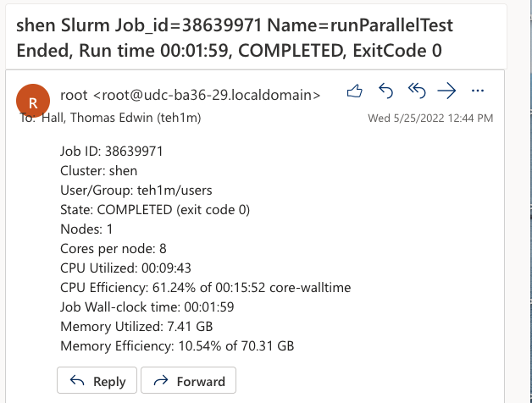
SLURM Script end-of-job email
When the job finishes, the end-of-job email sent by SLURM will contain the output of the SLURM seff command.

Slide 45
SLURM Script Example for Python
A SLURM script is a bash script with SLURM directives (#SBATCH) and command-line instructions for running your program.
#!/bin/bash
#SBATCH --nodes=1 #total number of nodes for the job
#SBATCH --ntasks-per-node=1 #how many copies of code to run
#SBATCH --time=1-12:00:00 #amount of time for the whole job
#SBATCH --partition=standard #the queue/partition to run on
#SBATCH --account=myGroupName #the account/allocation to use
#SBATCH --mail-type=end. #send email when job ends
#SBATCH --mail-user=mst3k@virginia.edu #my email address
module purge
module load anaconda/2020.11-py3.8 #load modules my job needs
python myProg.py #command-line execution of my job

Slide 46
Submitting a Slurm Job
To submit the Slurm command file to the queue, use the sbatch command at the command line prompt.
For example, if the script on the previous slide is in a file named job_script.slurm, we can submit it as follows:
-bash-4.1$ sbatch job_script.slurm
Submitted batch job 18316

Slide 47
Submitting an Interactive SLURM Job
To submit an interactive SLURM job to the queue, use the ijob command at the command line prompt.
For example, if you want to run an interactive application on a compute node in the standard queue using one cpu, we can submit it as follows:
-bash-4.1$ ijob –c 1 –p standard –A MyGroupName -t 06:00:00
﻿salloc: Pending job allocation 21640112
salloc: job 21640112 queued and waiting for resources
salloc: job 21640112 has been allocated resources
salloc: Granted job allocation 21640112
srun: Step created for job 21640112
udc-aw34-21c0-teh1m$

Slide 48
Checking Job Status
To display the status of only your active jobs, type:
squeue –u <your_user_id>
-bash-4.2$ squeue –u mst3k
JOBID PARTITION NAME USER ST TIME NODES NODELIST(REASON)
standard job_sci mst3k R 1:45 1 udc-aw38-34-l
The squeue command will show pending jobs and running jobs, but not failed, canceled or completed job.

Slide 49
Checking Job Status
To display the status of all jobs, type:
sacct –S <start_date>
-bash-4.2$ sacct –S 2019-01-29
3104009 RAxML_NoC+ standard hpc_build 20 COMPLETED 0:0
3104009.bat+ batch hpc_build 20 COMPLETED 0:0
3104009.0 raxmlHPC-+ hpc_build 20 COMPLETED 0:0
3108537 sys/dashb+ gpu hpc_build 1 CANCELLED+ 0:0
3108537.bat+ batch hpc_build 1 CANCELLED 0:15
3108562 sys/dashb+ gpu hpc_build 1 TIMEOUT 0:0
3108562.bat+ batch hpc_build 1 CANCELLED 0:15
3109392 sys/dashb+ gpu hpc_build 1 TIMEOUT 0:0
3109392.bat+ batch hpc_build 1 CANCELLED 0:15
3112064 srun gpu hpc_build 1 FAILED 1:0
3112064.0 bash hpc_build 1 FAILED 1:0
The sacct command lists all jobs (pending, running, completed, canceled, failed, etc.) since the specified date.

Slide 50
Canceling a Job
To delete a job from the queue, use the scancel command with the job ID number at the command line prompt:
To cancel all your jobs, run this command:
-bash-4.2$ scancel 18316
-bash-4.2$ scancel –u $USER

Slide 51
JupyterLab

Slide 52
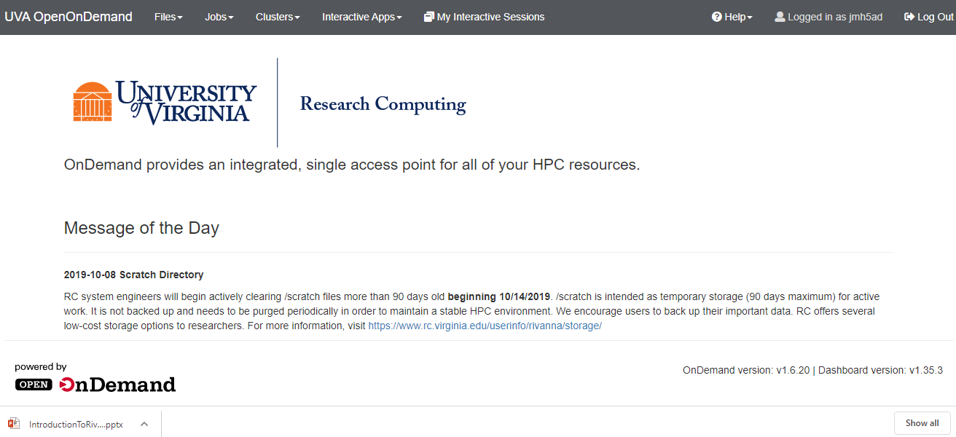
Open OnDemand Dashboard
Open OnDemand is the software that we use to create our web portal to Rivanna.
As soon as you see the Dashboard (shown below), you are connected to Rivanna.

Slide 53
Open OnDemand Dashboard
The Dashboard gives you links to various applications.
To see the links, click on “Interactive Apps” on the menu bar.

Slide 54
Links to Applications
Today, we are going to look at JupyterLab and Rstudio Server.

Slide 55
JupyterLab
Click on JupyterLab.

Slide 56
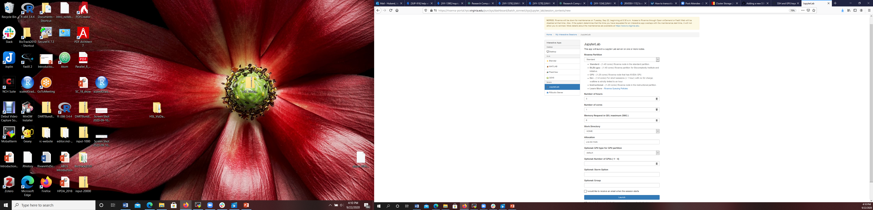
JupyterLab Web Form
The Jupyter Web Form gathers information about the computing resources that you need for your Jupyter Notebook.
After you fill in the form, it will re-populate with the same settings the next time that you connect to it.
Let’s look at how you would fill it in!

Slide 57
Rivanna Partition
Recall that Rivanna has lots of Compute Nodes.
The nodes are partitioned (i.e., organized) by the type of processing that they can do.
Most of the time, you will select the Standard partition.
If you are running a deep learning model, you will want to choose a GPU Partition.

Slide 58
Number of Hours
The “Number of hours” is the amount of time that your session will be active.
Beware! When time runs out the session will end without warning!

Slide 59
Allocation
The allocation is a special MyGroups group that allows you to have access to Rivanna.
You must be a member of a Rivanna-enabled MyGroup to have an active account.
In general, your professor or research advisor will add you as a member to an allocation.
You can have membership in more than one allocation.

Slide 60
Launch
Clicking on the “Launch” button will submit a request for the resources that you want.
There will be a slight delay before the resources are available.

Slide 61
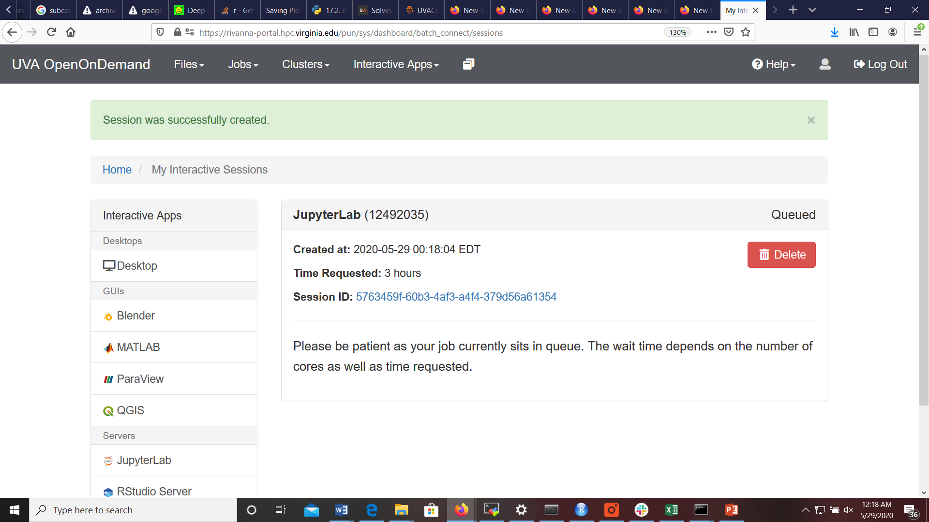
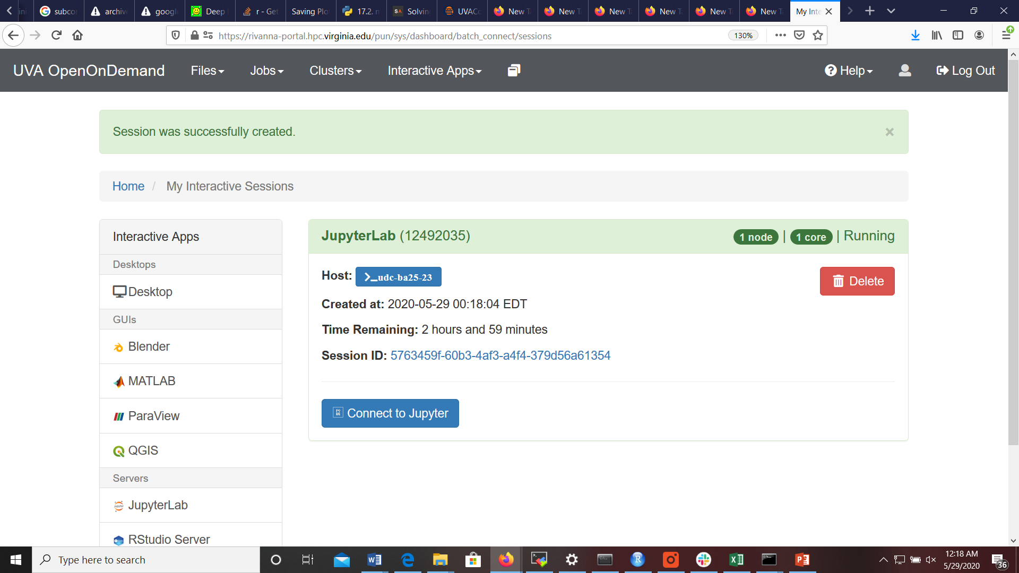
Waiting for the Session to Start
The screen will transition from a “Please be patient” statement to a “Connect to Jupyter” button.
Click on the “Connect to Jupyter” button.

Slide 62
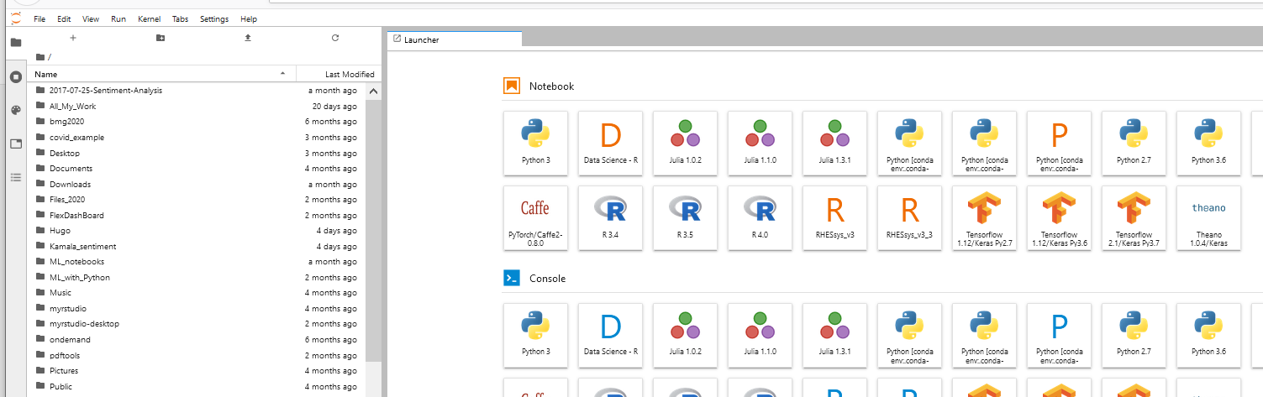
Hands-on Activity
Connect to Open OnDemand and start a JupyterLab session.
When it comes up, you will see a list of files (if any) in your home directory and a set of tiles for underlying applications (e.g., Python, R, Tensorflow).
You may see a slightly different set of tiles in your account – there are some customized tiles in this account.

Slide 63
Deleting Your Session
When you are done with your Jupyter Notebook, it is very important to delete the session.
Go back to the browser tab labeled “Interactive Sessions” and click on the red “Delete” button.

Slide 64
Rstudio Server

Slide 65
RStudio Server
Return to the Dashboard tab and click on RStudio Server.

Slide 66
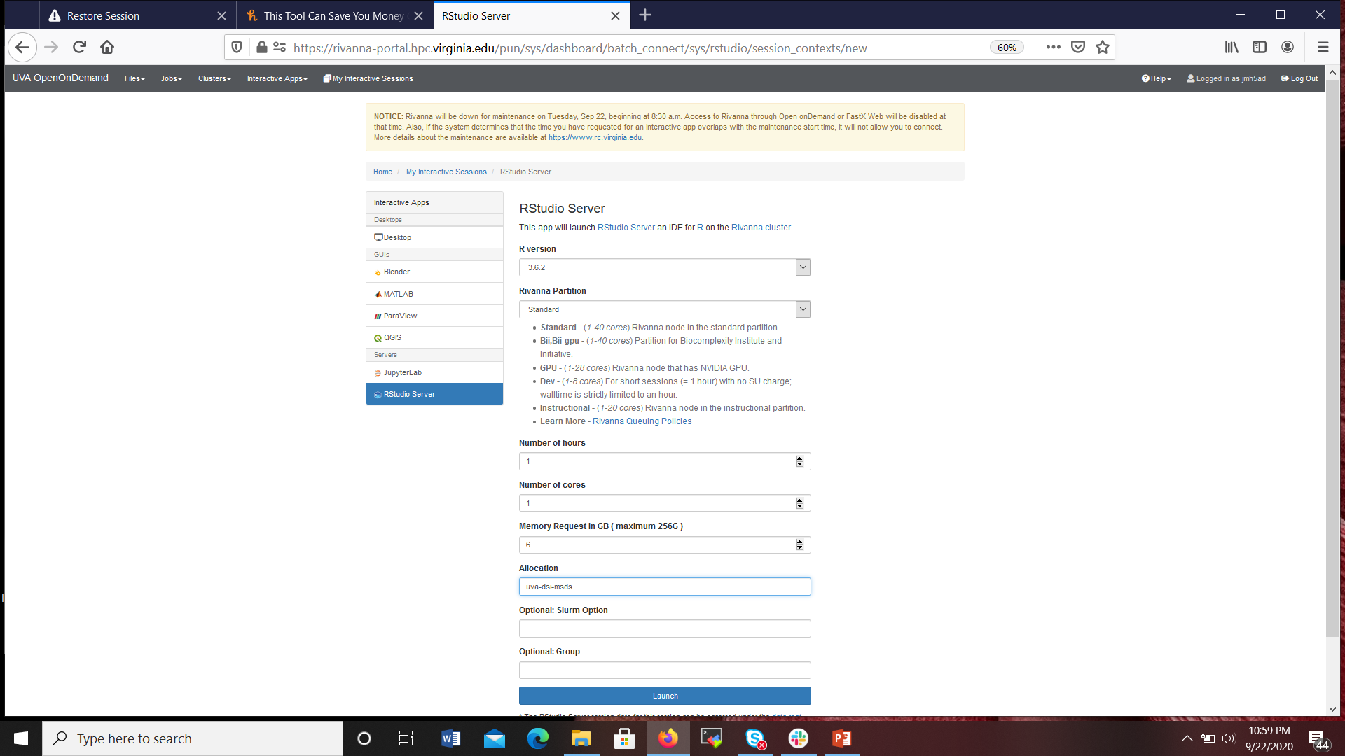
RStudio Web Form
The RStudio Web Form is similar to what you saw with the Jupyter Web Form.
Let’s take a quick look at some of the fields.

Slide 67
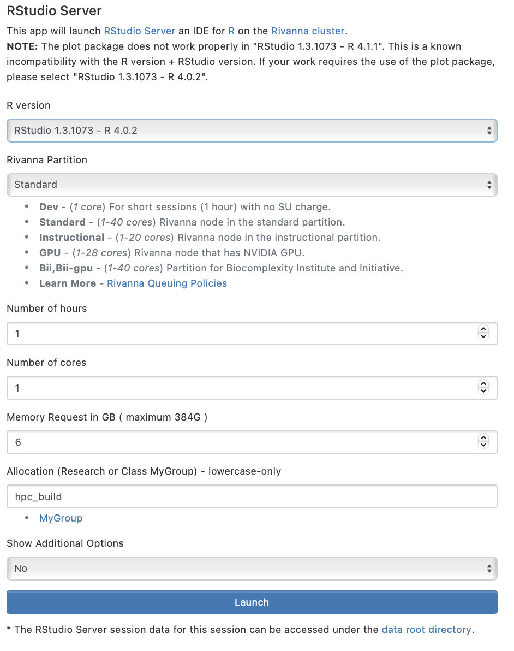
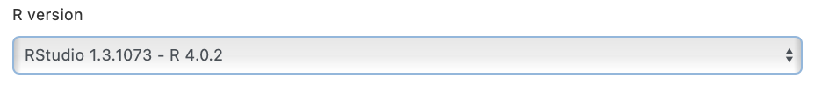
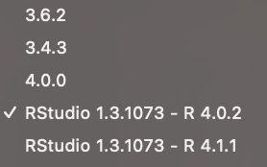
R Version

Slide 68
Rivanna Partition
The partitions are the same as in the JupyterLab Web Form, but we recommend mostly Standard, Dev, or Instructional for RStudio Server.

Slide 69
Number of hours & Allocation
The Number of hours and the Allocation are the same as in the JupyterLab Web Form.

Slide 70
Launch
Clicking on the “Launch” button will submit a request for the resources that you want.
Again, there will be a slight delay before the resources are available.

Slide 71
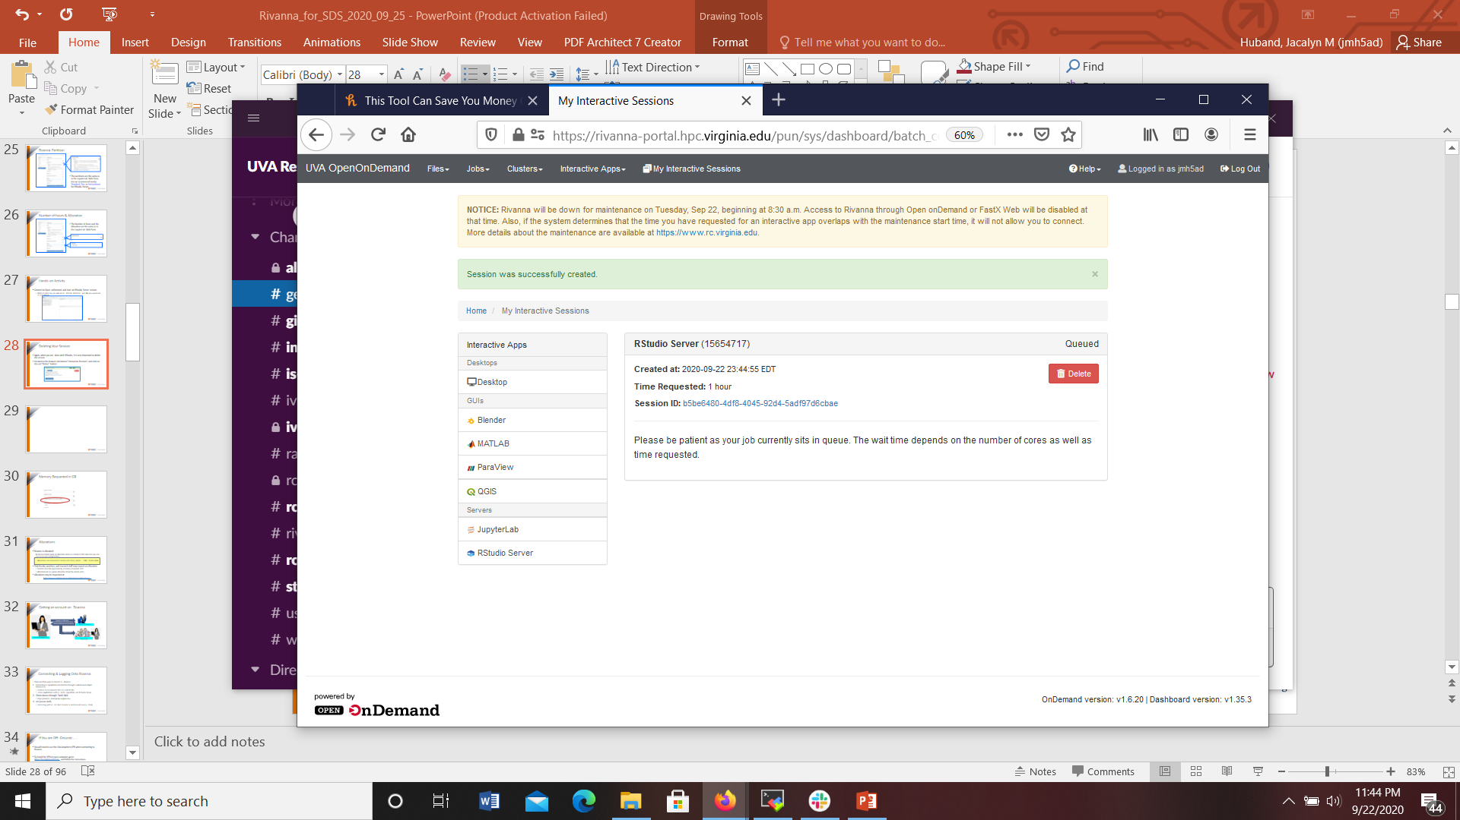

Waiting for the Session to Start
The screen will transition from a “Please be patient” statement to a “Connect to RStudio Server” button.
Click on the “Connect to RStudio Server” button.

Slide 72
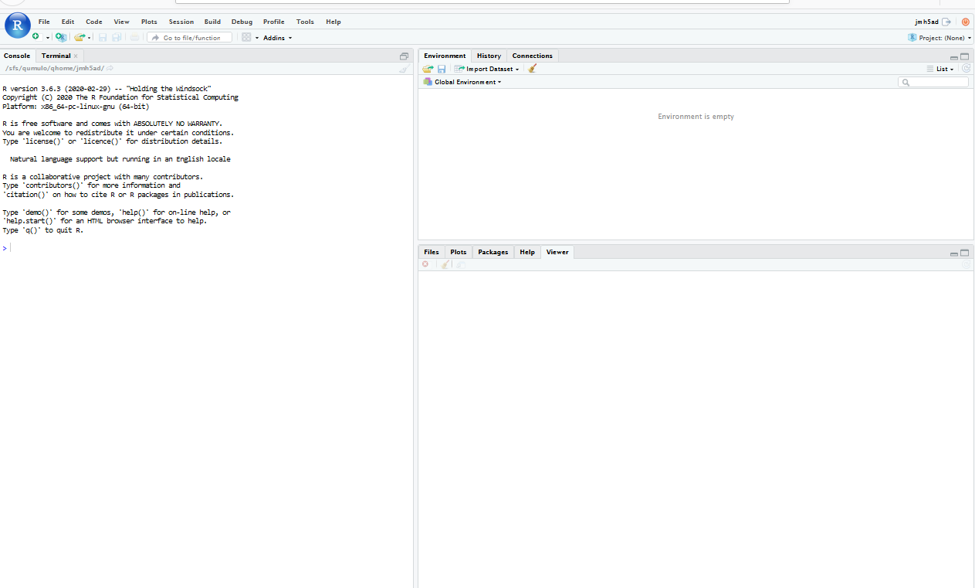
Hands-on Activity
Connect to Open OnDemand and start an RStudio Server session.
When it comes up, you will see an RStudio interface – just like you would see on your laptop.

Slide 73
Deleting Your Session
Again, when you are done with RStudio Server, it is very important to delete the session.
Go back to the browser tab labeled “Interactive Sessions” and click on the red “Delete” button.

Slide 74
What about the other fields?
Field | Description
Number of cores | Used in parallel processing. Your code must be modified to take advantage of using multiple cores.
Memory Request in GB | When dealing with Big Data, you will need to increase the amount of memory. My rule-of-thumb: request 2 to 3 times the size of data that you are reading in or generating.
Work Directory | Allows you to change the working directory of a Jupyter Notebook to your /scratch folder.
Optional: Slurm Option | Allows you to provide advanced features, like requesting specific nodes or providing a reservation
Optional Group | Only needed in you are in more than 16 allocations. You may need to force Rivanna to see your allocation.
Optional: GPU type for GPU partition & Optional: Number of GPUs | Only needed in you are running on a GPU node. The “default” for GPU type will put you on the first available GPU node. For now, the number of GPUS should be 1.
You may have noticed fields on the Web Forms that we left blank or stayed with the default values.
The most important one will be the Memory Request

Slide 75

Need help?
Research Computing Zoom Office Hours
Tuesdays: 3 pm – 5 pm
Thursdays: 10 am – noon
To connect to the Zoom sessions, go to https://www.rc.virginia.edu/support/#office-hours and click on the “Join us via Zoom” button
Or, contact us through the forms at:
https://www.rc.virginia.edu/support/

